Slide 1
Awesome Code Crafters Hub
Team 4 Craig Collins (1038789)
James FALLOUH (6171620)
SeyedehFatemeh Fekribaygi (6284424)

Slide 2

Purpose/RationalE
Address the labour shortage in Québec
Provide Québec employers with an online resource
Easily find up-and-coming programmers
Provide programmers with a venue to market themselves
Enable them to leverage their talents immediately
No talents going to waste
Bilingual website

Slide 3

Target audience
Québec Employers
Lacking effective recruitment strategies
Need programmers fast that meet industry standards, not just self-taught
French proficiency
Local integration
Programmers
Diverse background and demographics
Various skill levels and expertise
Seeking opportunities for career entry
Interest in showcasing portfolio/projects

Slide 4
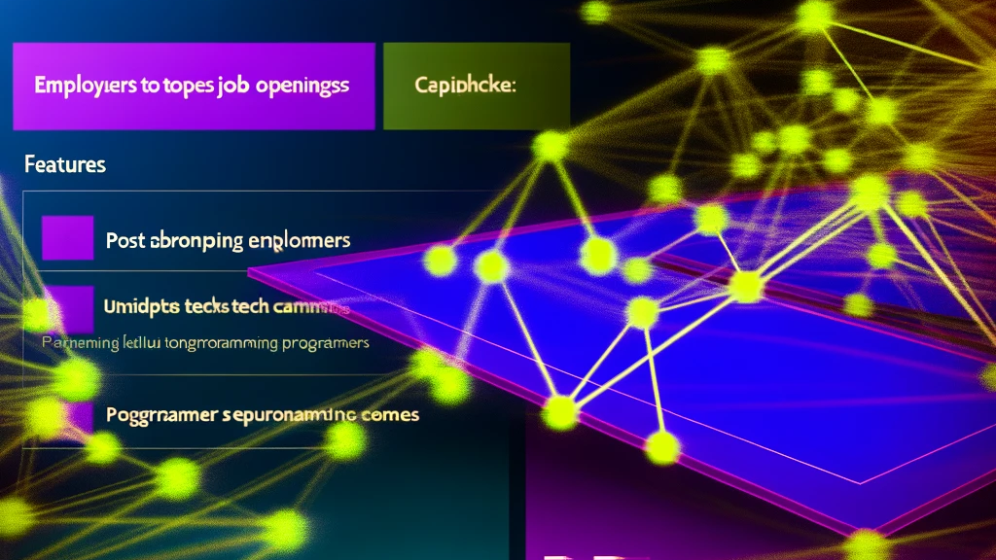
Problem/Solution
Problem
Labour shortage for computer programmers in Montréal
Reduced immigration contributing to the shortage
Impact of the COVID-19 pandemic exacerbating situation
Solution
Creation of a website to address the issue
Features of the website:
Listing resumes of potential candidates
Providing a platform for employers to post job openings
Job/internship listings
Forum
Alleviate impact of labour shortage

Slide 5

Consulted websites
Code Crafter Hubs
https://code-crafters-hub.com/
https://codecrafthub.com/
Collective Blogs
https://css-tricks.com/
Shared Portfolios
https://www.viget.com/work/
https://www.hugeinc.com/

Slide 6
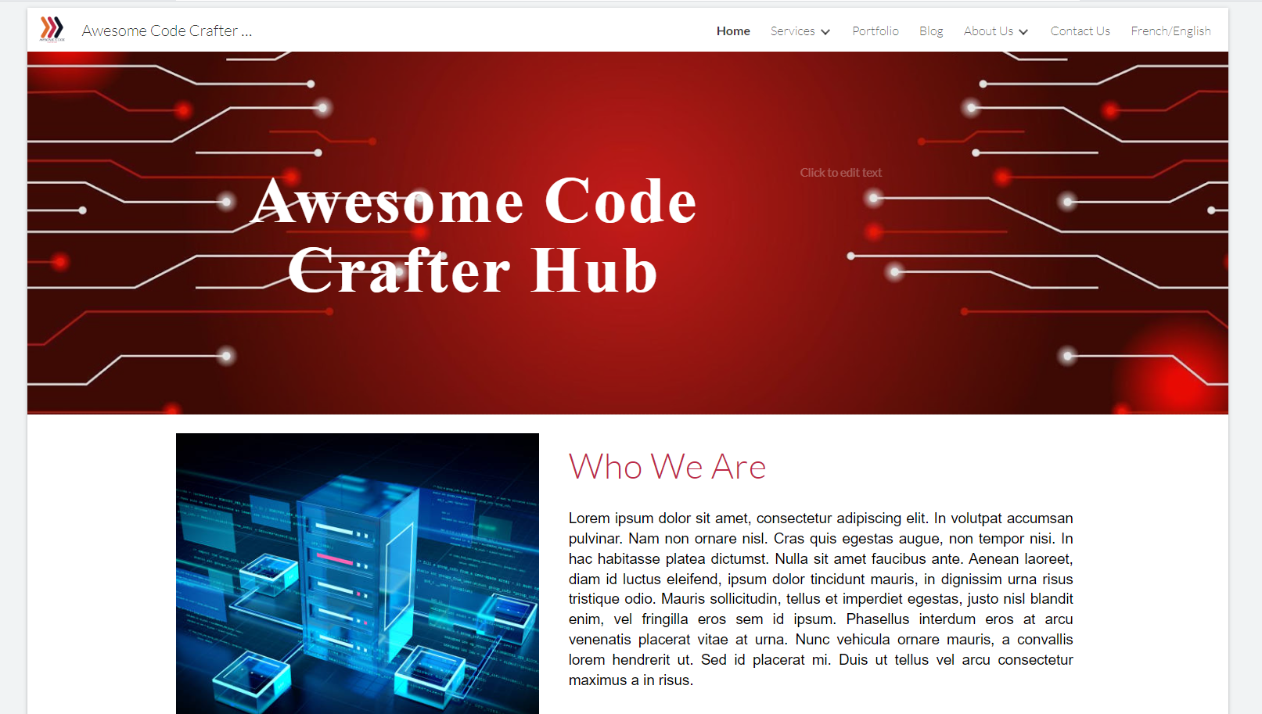
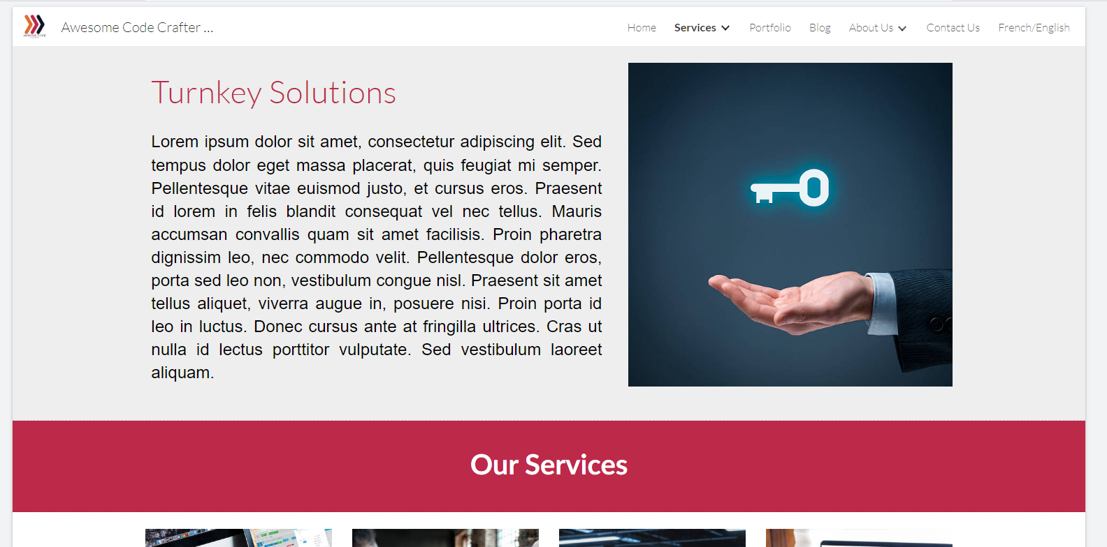
Mockup
Notes:
Font awesome, syntactically awesome fonts

Slide 7
Navigation Structure
Awesome Code Crafters Hub
Index (English)
Blog
Contact Us
FAQ
Portfolio
About Us
Services
Article
Contact Us (Completed)
Craig Collins
James Fallouh
Fatemeh Fekribaygi
Databases
Programming
Web Development
Website Design
Index (French)
Blogue
Contactez-nous
FAQ
A propos
Services
Article
Contactez-nous (terminé)
Portefeuille
Craig Collins
James Fallouh
Fatemeh Fekribaygi
Base de Données
Conception du site web
Développment web
Programmation

Slide 8

Complications
Conflicting CSS
Using !important to override custom.css
Mockup tool
Limited, not easily replicated
Navigation bar
Top dropdown button would not permit clicking
Change to open on hover
Form
No back-end server
Method=“action“ not method="post"

Slide 9
Unrealized potential
Forum Page
Job Listings Page
Account/Profile Creation

Slide 10

Any questions?

